Slide 1
VB.NET Programming
Unit : 4

Slide 2
Object Oriented Programming
Classes & Objects
Properties, Methods and Events
Access Specifiers: Public, Private, Protected, Protected Friend
Me, MyBase and MyClass
Abstraction, Encapsulation & Polymorphism
Interfaces & Inheritance

Slide 3
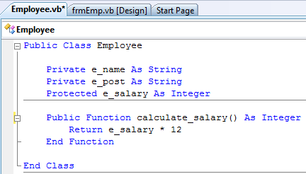

Class & Objects

Slide 4
Access Specifier
Public
anywhere in the same project, from other projects that reference the project, and from any assembly built from the project
Private
within the same module, class, or structure
Protected
Within the same module, child class
Friend
From the same Assembly
Protected Friend
Combination of Protected with Friend

Slide 5
Inheritance
Parent Class / Base Class
Child Class / Derived Class
Constructor / Destructor
Me, MyBase and MyClass

Slide 6
Polymorphism
Function Overloading
Use “Overload” keyword with function/subroutine name
Function Overriding
Use “Overridable” keyword in parent class function definition
User “Overrides” keyword in child class function definition

Slide 7
Abstract Class
Use “MustInherit” keyword to make abstract class
Use “MustOverrides” keyword to make abstract method

Slide 8
Final Class
“MustNotInherit” keyword use to make a final class

Slide 9
Interface
Interface structure
Inheritance in Interface
Difference between Interface and Abstract Class

